Slide 1
TRAVELNOW!
TravelNow!
Notes:
(0:10)
Good morning, everybody.
Today we’ll be taking you through our process of design for TravelNow!’s new digital architecture and online presence

Slide 2

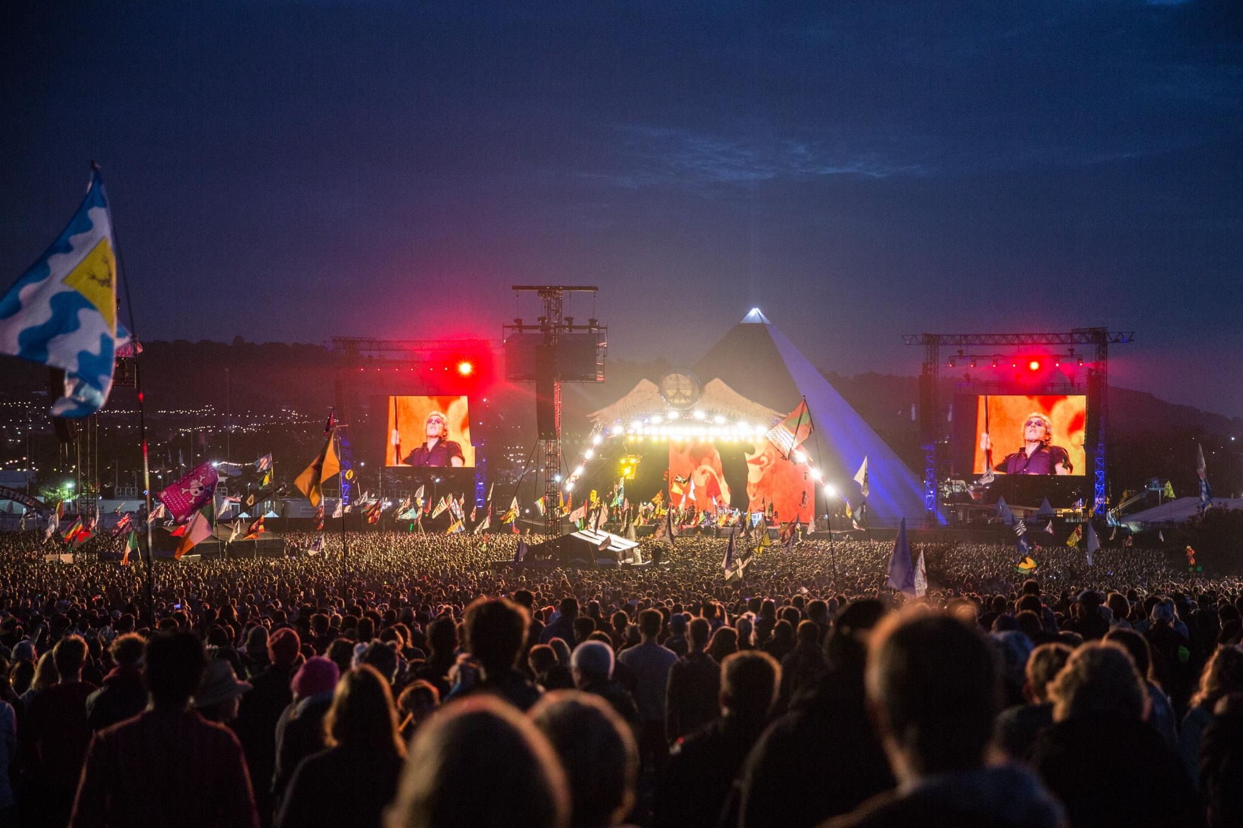
Explore by Categories
What are you looking for?
Welcome, Guest
Customize Your Business Travel Plans to add from 1500+ Activities Around the World
Sign Up
Log In
Glastonbury Festival
Somerset, England
Click to Explore
Notes:
1:10
Before we get into anything
Mockup of our proposed design.
This is the welcome page, first thing that users (especially those unfamiliar with TravelNow!) will see
Simple, not cluttered. Allows people to browse through featured global attraction suggestions
Imagine businessman, traveling to a new place for a conference (visiting suppliers, development course, etc.)
doesn’t know what kinds of events or activities are happening around him
these days b. travellers mixing in leisure time && people in general want experiences
Business trips are potentially stressful journeys, we want to help travellers experience ease as they prepare for them
Logo From: https://www.graphicsprings.com/start-your-logo

Slide 3

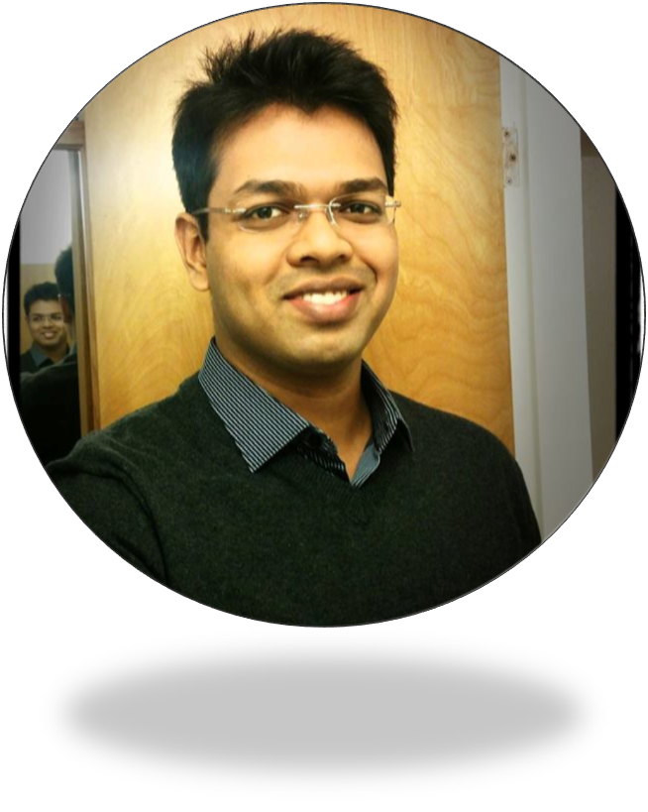
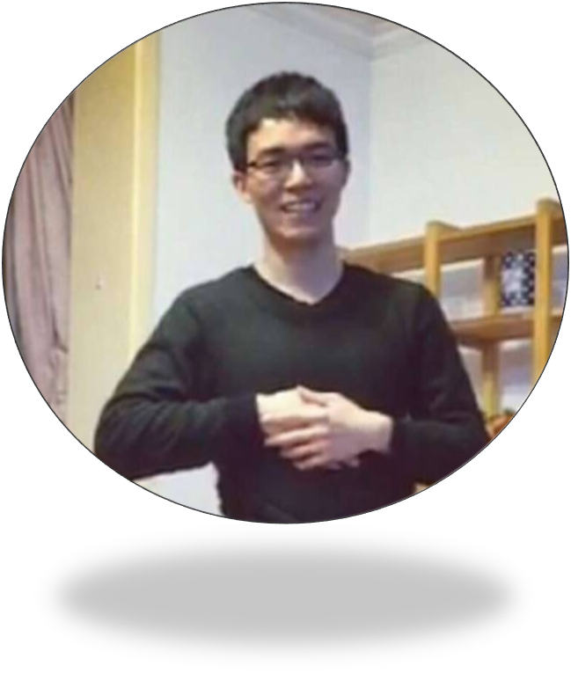

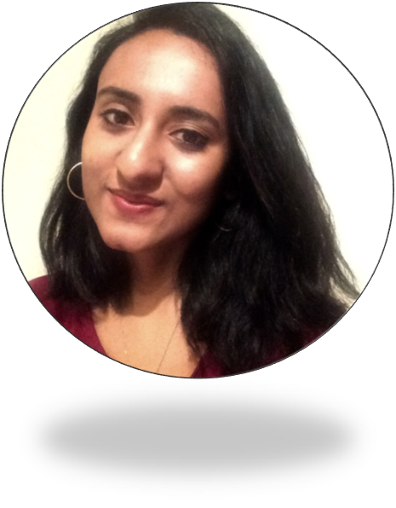
Group 4
Edmund Deng
Anurag Banerjee
Chaofan Han
Elton Sequeira
Gargi Saha
Account Director & Project Manager
User Experience Designer
Taxonomist
Content Manager
Information Architect
Notes:
(1:15)
We’ve designed a new information space that will develop the TravelNow Brand and help ICT meet its business goals.
This simplified and uniform design allows businesspeople (often pressed for time & saturated with ideas) to more effectively access and use information regarding their travel.
The site allows travellers to pre plan itineraries, research destinations, connect with locals, and enjoy their journeys
To promote effective navigation through this space, which helps your customers navigate physical spaces, we need to work together to build a strong foundation in Information research, strategy, management, relationships, and organization.
With this new digital presence, TravelNow! customers will notice a simplified navigation experience compared to previously because information has been effectively organized.

Slide 4
Overview
Strategy
Research
Design
Next Steps
Notes:
(1:20)
Today, we’ll be discussing our development process from the outset through to next steps.
Strategy → in regards to business, online, content
We’ll talk about how we approached tailoring an information structure to your needs
We’ll also propose a Vision & Mission statement for TravelNow! that will help the brand re-establish its relationships with customers and communities
Research → data we’ve obtained from users
Surveys & Card Sorting
Interviews
and User profiles (or personas)
Design → Where we went with content & functionality
sitemap (to help guide you through this space)
taxonomy (describing the relationships between content)
wireframes (to help give you an idea of what the site will look like after it’s been created
Use Cases ( show you how a customer might approach this site)
Next Steps → How we will work together to achieve these goals

Slide 5
Strategy
Aligning Business and Technology Goals
Notes:
(0:35)
Strategy allows our Information Architecture to effectively combine:
Content - Existing structures, Content Objects,
Context - Business Goals, Resources, Technology, Constraints
Users - Needs, Tasks, Information Seeking Behaviors
The strategy development process involved:
thinking about creative ideas
articulating them with diagrams or scenarios
communicating by presenting, testing, and reiterating
It allows us to connect the research that we’ve done, which we’ll actually get to shortly, with the design of the information space

Slide 6
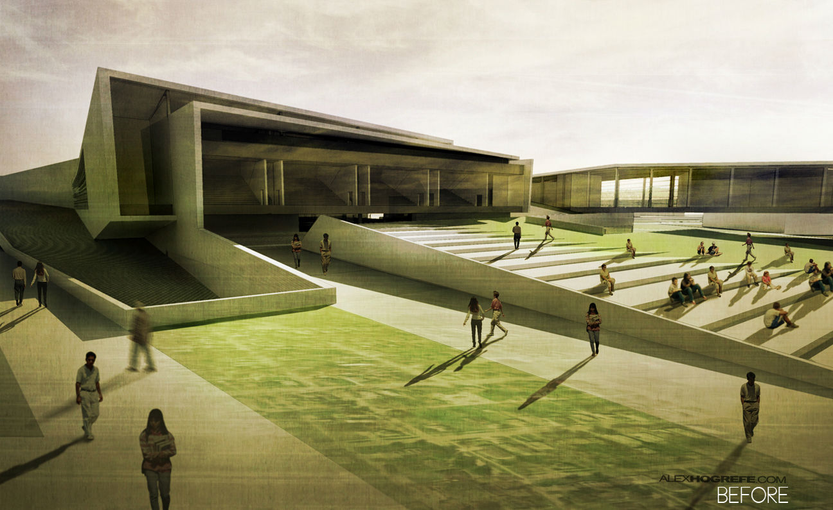
Information Space
Community Building
Brand Recognition
Bleisure
Notes:
(1:20)
Just like a physical space, people navigate an information space in a multitude of ways
Allowing us to design an effective Information architecture will create a focus on:
Multimedia content in the form of (Guidebooks, Trip Research, How-to Videos)
Community building (Forum discussions)
Travel Product Purchases & better utilization of physical locations & GetOut! personnel
By Nurturing sustained customer & community relationships.
Providing resources like articles, instructional videos
Allocating staff directly for advice on trips, with the GetOut! Initiative
Users contribute to ecosystem with their own content
People will better identify with the TravelNow! Brand & can help repair its “broken” Online Presence
With our design framed around the business traveller’s needs for simplicity & efficiency,
TravelNow! can become the go to in the growing business-leisure market for travel-related products & booking adventure trips
Our online strategy for TravelNow! will help it become well known and integrated with Bleisure Travel
Alex Hogrefe. Architecture [Digital Image]. Retrieved from: http://www.arch2o.com/wp-content/uploads/2015/09/Arch2O-Architectural-Hand-Drawings-vs-Digital-Renderings-10.jpg

Slide 7
Vision
Mission
Simple Tailored Journeys
To create unique travel experiences for business travellers by offering the ability to research and arrange leisure activities around work engagements.
Notes:
(0:30)
Our team proposes the following Vision and Mission for the TravelNow! Brand
We want to help travellers have Simple Tailored Journeys .
This means that we want the experience to be intuitive and enjoyable (so that customers keep coming back for more)
The sleek new interface allows a diverse range of users to personalize their trips & maximize their enjoyment

Slide 8
Research
Crafting a Brand that Customers Want
Notes:
(1:00)
Reasons for Research -
Waste of money/time?
Describe why it is important
User needs should drive site functions and interface, navigation, and information design
think of the analogy of the iceberg: Before users can navigate(top), a lot of work goes into proper, effective design. Data helps subsequent decisions be more effective
Research can be used to refine strategy and define scope and structure of project

Slide 9
User Research
Target Market
Exploration
Utilization
Notes:
(0:30)
We chose to focus on
colleagues with bleisure experience
diverse age range and experience
conducted surveys and interviews to determine what they needed
We wanted to explore:
what was most important to these people
to learn about what they wanted, but might not offered at the moment
How we would use this information
As previously stated, research gave us a solid foundation moving forward into subsequent phases of design

Slide 10
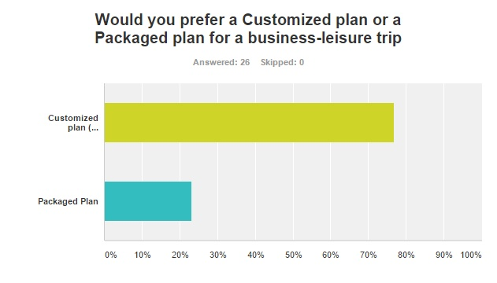
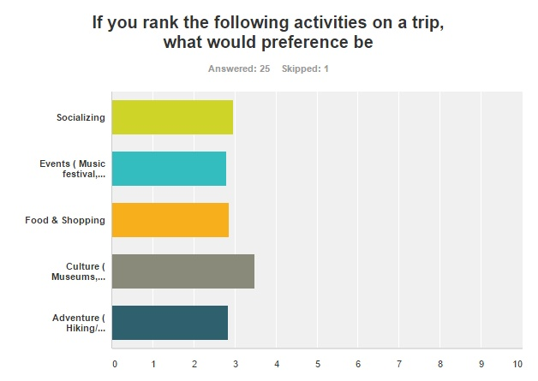
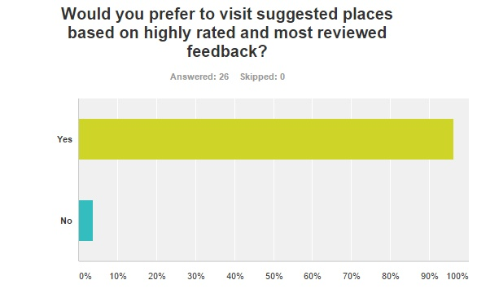
Notes:
Sent out a survey to colleagues and acquaintances with business travel experience
This is a sample of responses that we thought were most relevant to determining an effective strategy and design
These responses also helped us determine the kind of content or functions expected of a site like this

Slide 11
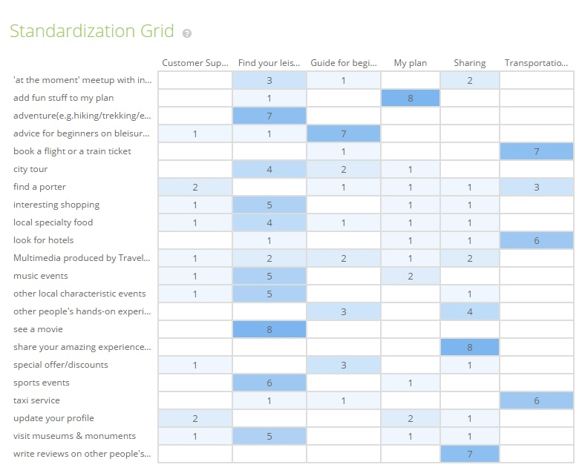
Notes:
In addition, we performed a card sort to determine the best way of grouping our content and allow people to navigate effectively
Some obvious ones
advice for beginners went frequently into ‘guide for beginners’
sports events, movies, local food went into ‘find your leisure’ which we later renamed to ‘activities’
Also some outliers, not shown here
grouping each activity into separate sections (music, art, food) → we later subdivided activities as a result of this
ignoring our categories completely and creating separate ones → we used this to influence naming conventions

Slide 12
Targeted Interview
How do you typically go about deciding what attractions or locations to visit?
“I tend to base my decisions on reviews that I read about the place. I worry that if I go to try a new place on my own, it won’t be as good as another place that somebody else recommends.”
Is there a particular method that you prefer to use when navigating through a website?
“I typically look for particular pieces of information and products, and I don’t want to see everything else. Stay simple; provide me with a way to find just the products I’m most-interested in seeing. I want to be able to quickly find the exact type of product I’m looking for, without inappropriate results showing up.”
Notes:
Unable to gather people to conduct focus groups, but able to find specific information from users in interview.
First question: how you decide what to visit.
Answer was about ratings and reviews, so we included this function in website. Users can see ratings when they browse activities and read reviews in the community sharing section. The Top rated helps people choose from collective favorites.
Second question: How do go about finding what you need on a website
Answer about particular searches or relevant information, so we developed global search that displays most relevant items (based on taxonomy/content tags)
-Quote from textbook, find source. Cite & Reference
Pass to Anurag

Slide 13
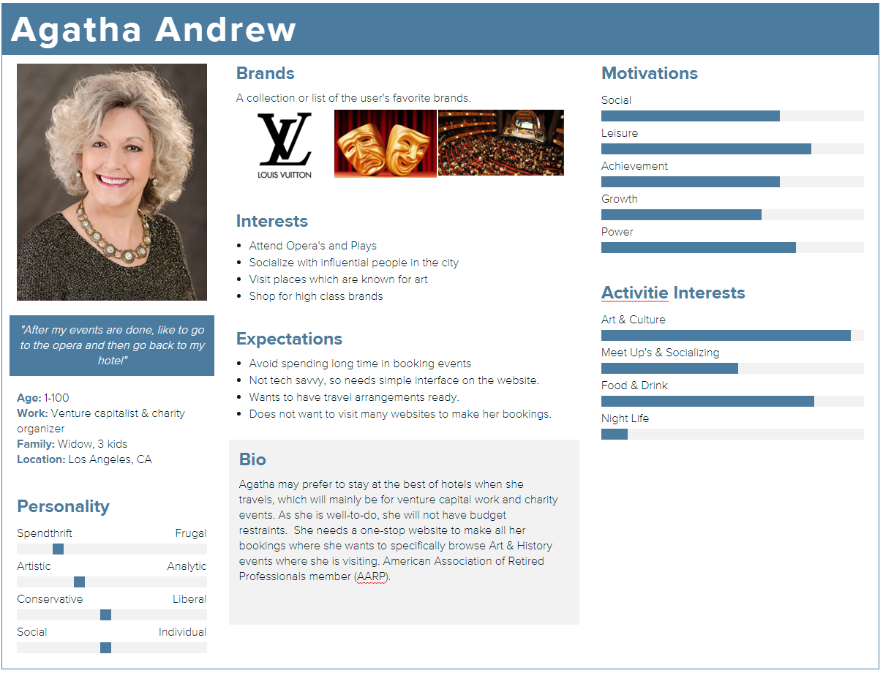
Notes:
Anurag

Slide 14
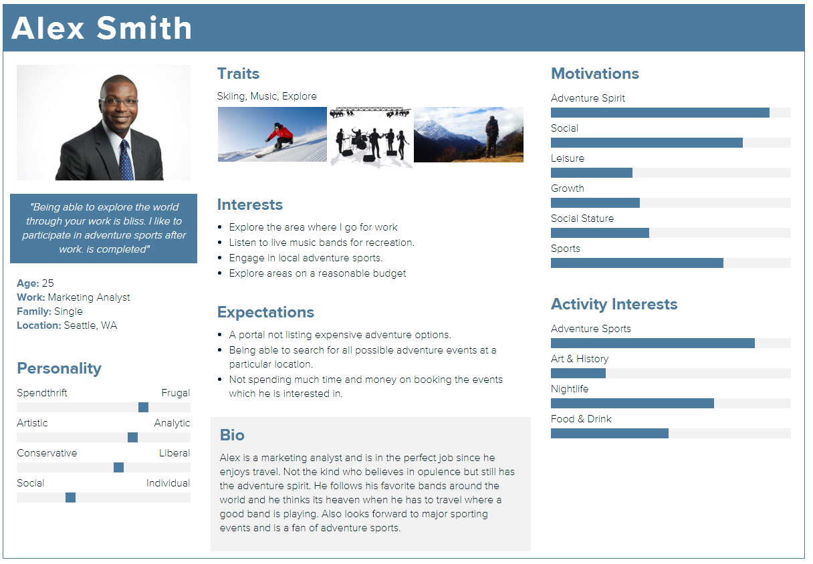
Notes:
Anurag

Slide 15
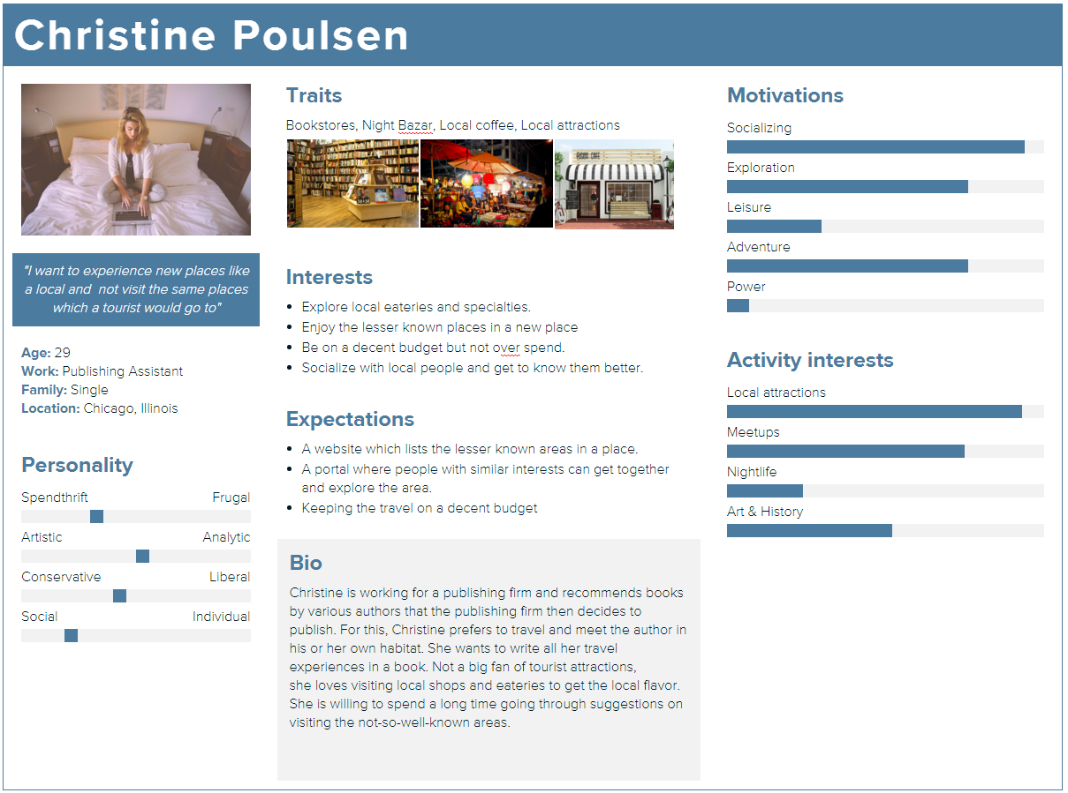

Slide 16
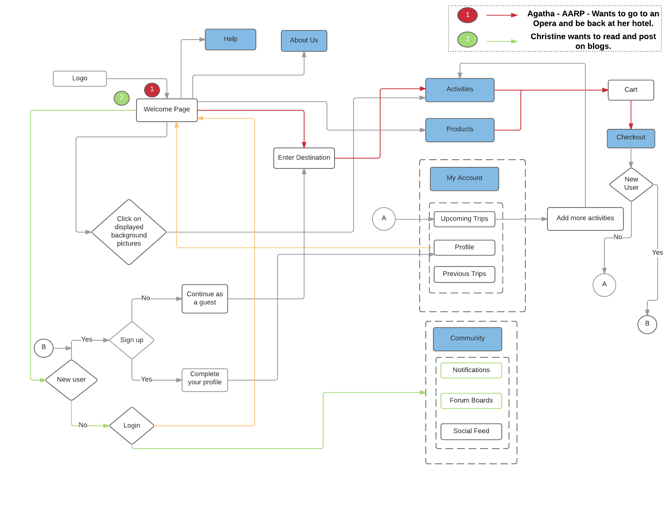

Slide 17
Content Strategy
Relevant
Recommended
Intuitive
Assist
Notes:
Began with competitive analysis of other travel services.
Searched for sample content & began mapping
Provide relevant content and recommendations to our members.
Provide recommended activities to guest users.
To help users acquire information at a glance and with minimal clicks.
To provide assistance to users through videos, chat and forums.
Elton - Quick walkthrough
SWOT - Week 3a Slide 27 Info

Slide 18
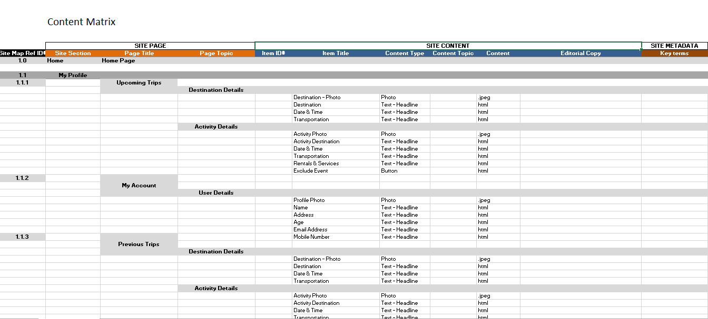
Content Matrix
Notes:
Began with competitive analysis of other travel services.
Searched for sample content & began mapping
Elton can give a quick summary of the content process
Elton - Quick walkthrough
SWOT - Week 3a Slide 27 Info

Slide 19


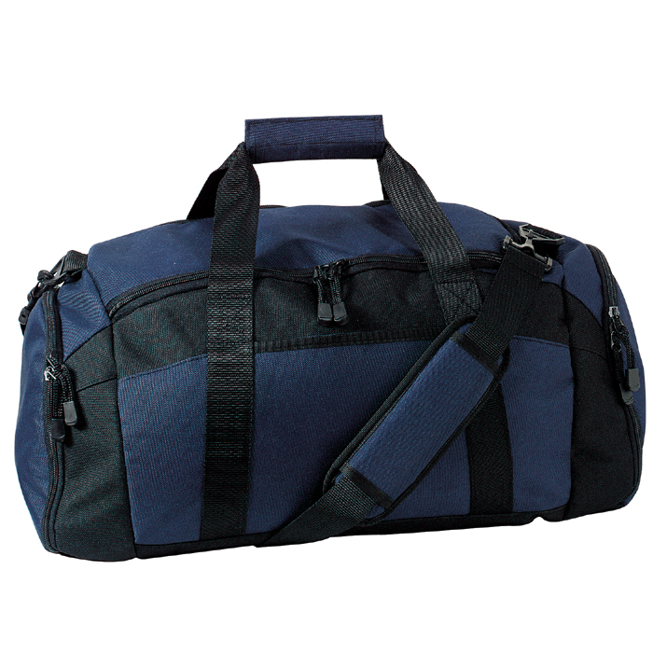
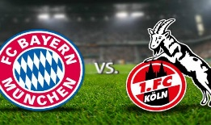




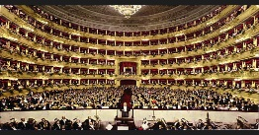



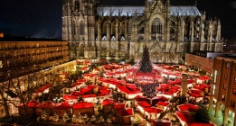




Cologne
Welcome, Agatha
My Account
Activities
Products
Community
Help
About Us
40% Discount on Duffle Bags. Offer lasts till 10 Dec, 2015
Top Rated
Food and Drink
Munich vs FC Koln
Add to Cart
Music
Arts & History
LA Opera
Add to Cart
Outdoor & Adventure
Shopping
Cologne Market
Add to Cart
Meet Up
Events
Open From
5 am – 2 pm
Transportation Type
Taxi Service
Public Transport
Get Directions
The most famous of markets is in the shadow of the Cologne Cathedral, the largest in Germany and a UNESCO World Heritage site.
With the imposing Gothic backdrop and the largest Christmas Tree in the Rhine, the ‘Am Dom’ Market (26 Nov - 23 Dec) offers over 160 stalls selling the traditional yuletide wares and their famous Glühwein (mulled wine). Traditional music fills the air, providing the perfect atmosphere for Christmas Shopping.
For Children, the Alter Market is the place to go, with a Santa’s Grotto, Puppet Theatre, and stands filled with toys. The Rudolfplatz will transport children both big and small to the world of the Brothers Grimm, with fairytale figures and festive illuminations.

Slide 20
Design
Crafting TravelNow! into an Industry Leader
Notes:
We’ll talk about how we’ll help TravelNow! craft its new image & differentiate itself from competitors
Sitemap: which shows relationships between pages and content, and illustrates organization and navigation
Taxonomy: which describes vocabulary and metadata
Wireframe: which shows how containers are organized

Slide 21
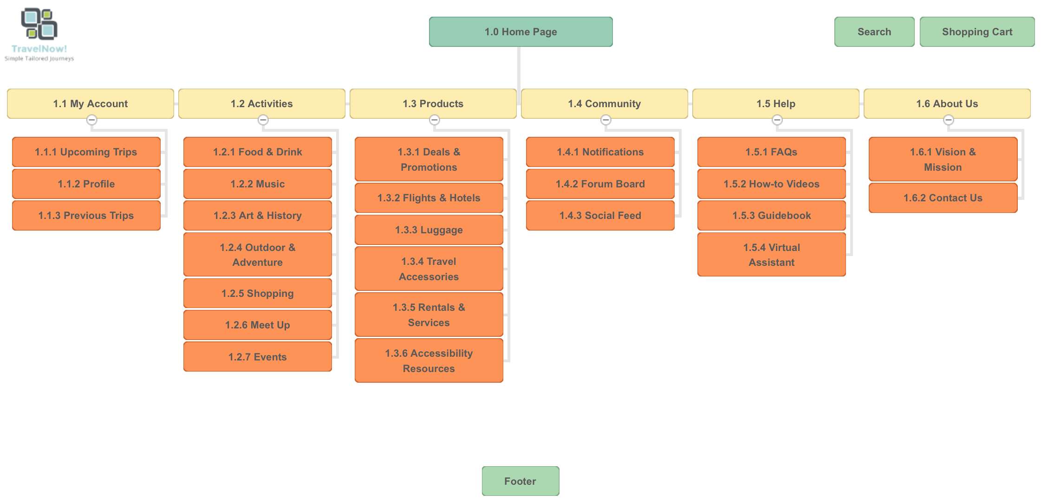
Sitemap
Notes:
Chaofan - Sitemap Walkthrough

Slide 22
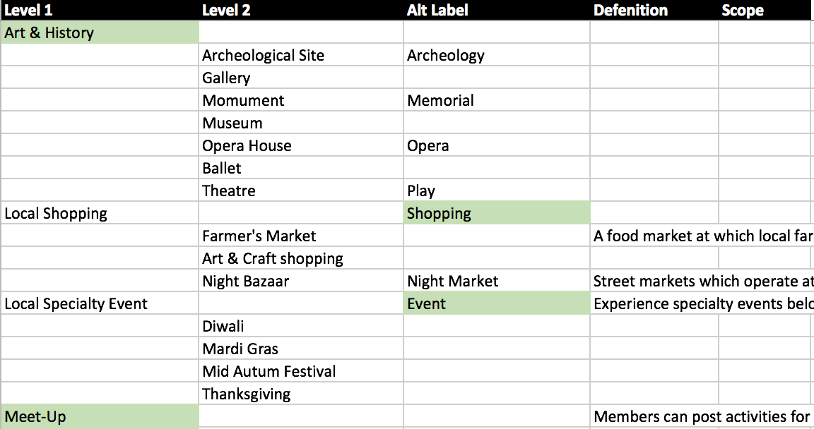
Taxonomy
Notes:
Chaofan - Naming Conventions, Content Tagging

Slide 23
Wireframes
Crafting TravelNow! into an Industry Leader

Slide 24
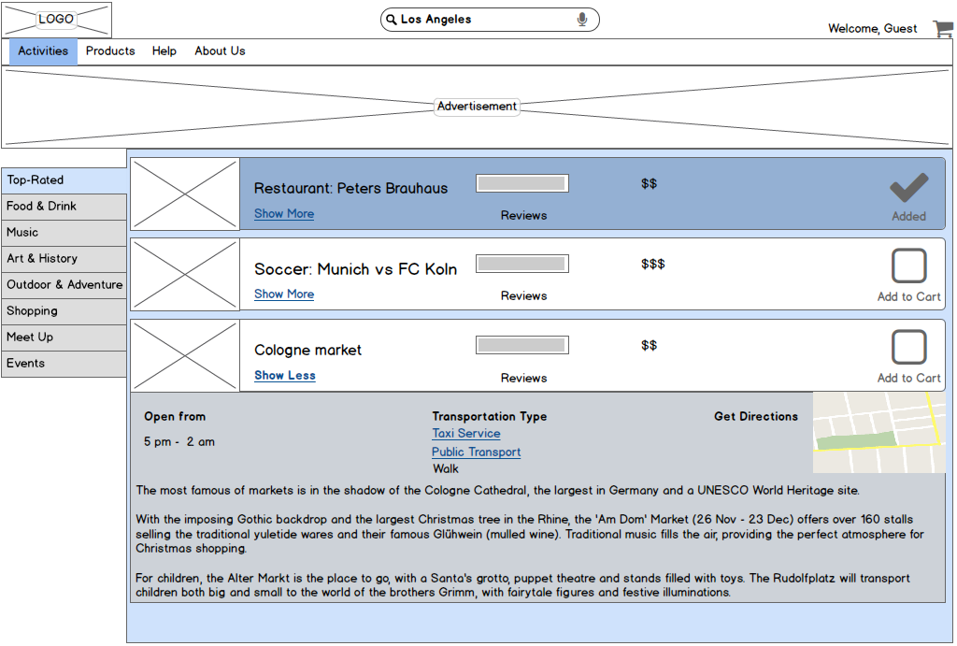
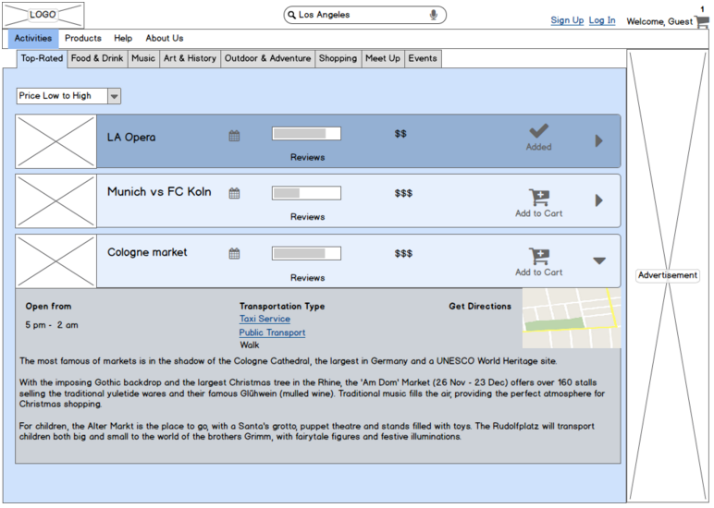
User Testing
A
B
Notes:
Gargi

Slide 25
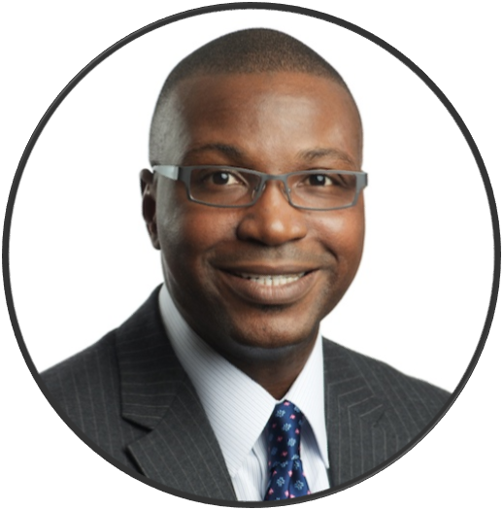

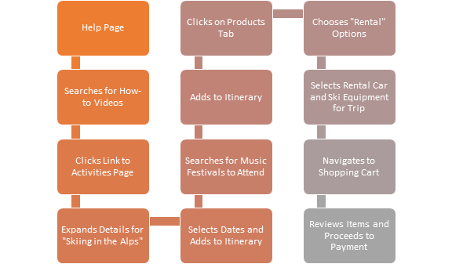
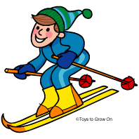

While I am in the area, I want to ski and attend a music festival
Notes:
Elton - walk through business use case
Young man - I want to go skiing (well known there) and my favourite music festival is also after my business seminar
Help (already logged into site, it remembers his credentials)
Enters the site structure from the side, instead of the top
Chooses ‘Help’ Section
Searches for videos about how to ski
Clicks hyperlink to adventure tab
Activities Page (automatically goes to adventure tab)
Selects skiing at the Alps/Auschwitz
Selects Dates
Selects Travel Type for To & Fro Travel
Adds to cart
Selects Music Tab (still in activitites)
Selects Music festival to attend
Selects Dates
Adds to cart
Products Page
Rental Tab - browses rental cars
Checks pricing options and adds to cart
Goes to My Profile/Shopping cart
Selects his upcoming trip and looks at what he has reserved
Checks out selections

Slide 26
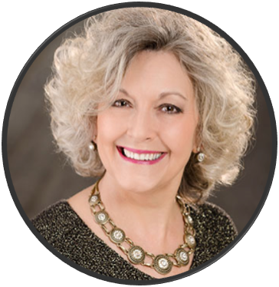

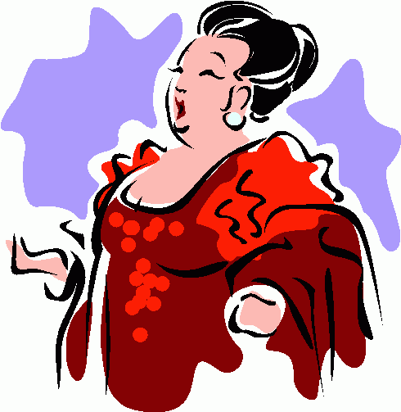
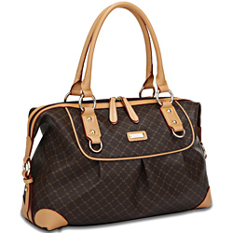

After my conference, I want to attend an opera and browse online products
Welcome Page
Continue into site as guest
Search for “Operas in Los Angeles”
Activities Page
Browse Top Suggestions
Select Preferred Show
Add to Itinerary
Products Page
Products Page
Shopping Cart
Shopping Cart
Browse for luggage items
Add desired item to shopping cart
Review Items for Purchase
Proceed to Checkout
Notes:
We’ve designed several use cases using our personas and designs.
Now that you’ve gotten a feel for the look of this site, we’ll walk through three difference scenarios
Retired Business Woman (AARP) - After office I want to go to an Opera and be back at my hotel.
Welcome, Continues as guest
Search for locations
Activities Page
Looks for Opera in Top Rated Activities
Selects Opera for dates and details
Adds selection to shopping cart
Products Page
Browse for luggage type
Adds Luggage to Shopping Cart
Shopping Cart
Check-out all selections
Optional Sign Up page, asks for demographic data w/ advertisement of deals & promotions
NOTIFICATION! as an AARP member, she receives 10% discount
Payment - Purchases Items

Slide 27
Next Steps
Architect for the Future
Notes:
to Architect - Design and Create, we’ll help TravelNow! stay ahead
talk about encountered challenges to completing project outcomes
talk about Methods used to address challenges
Allow us to further refine our ideas, then implement our designs
This will allow TravelNow! to thrive well into the future

Slide 28

IA: Meeting Business Goals & User Needs
Boost Product Sales
Grow the TravelNow! Brand
Hotspot for Travellers
Trip Planning Resources
Instructional Information
Community Content & Discussion
Relationships & Community Building
Notes:
Differentiator
GetOut! staff (virtual assistant) to provide connection and personalization
Risks
How will it make money for the client?
Most user interactions will end at the shopping cart page, the flow we’ve designed encourages booking & purchases
These days, people are concerned with buying experiences, so the focus on activities and events gives them an avenue to pursue their interests
Advertising revenue (in the site, but especially on the main banner)
Potential next steps for future phase(s) of work for the project
Web elements are beginning to mirror mobile design - this is where users are going
Will not cost much to develop Mobile Version and capture this market
Adding store locators - make those assets more valuable by letting customers know what’s near them
Looking further ahead - Wearables might be another step forward , lets users get a real feel for the spaces and activities before going

Slide 29
Thank You!
Questions?

